Slide 1

COMMUTER PROGRAMS
BEST PRACTICES WORKSHOP

Slide 2

Kristen Greig
Program Management Office Specialist
First MBUSA new hire in Atlanta in March 2015
PM for “Project Eagle”
GT Graduate + MBA Candidate
Worked for Southern Company at Plant Vogtle
Daily MARTA rider + 1-car family

Slide 3

Mercedes-Benz USA | Commuting & Mobility
Kristen Greig
June 2017

Slide 4
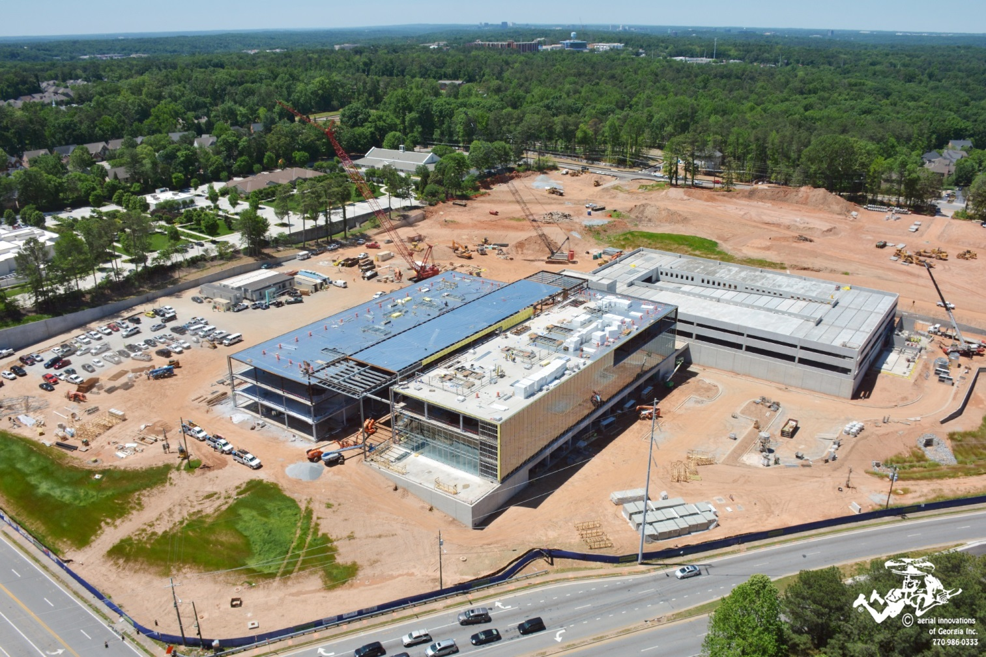
Coming in 2018: MBUSA HQ in Sandy Springs
Notes:
4

Slide 5
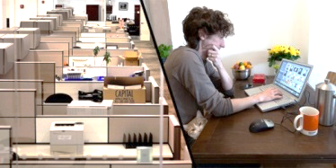
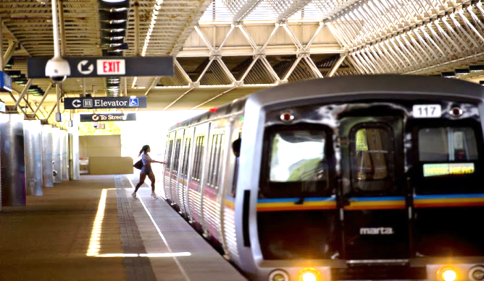
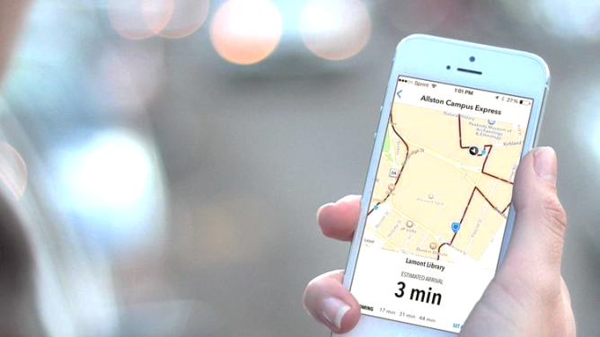
Commuting Strategy for MBUSA HQ
Teleworking + Flex Time
Pilot:1 to 2 days / week from home
Core/Flex Hours + Summer Hours Memorial Day through Labor Day
Goal: Enhanced productivity and heightened retention of valued employees
MARTA
“Help the company tap into the millennial talent who want to live in town, while also being close to executive-level housing in Buckhead and the northern Atlanta suburbs.”
Daily MARTA usage ~20 people
Digital Shuttle Tracking
HQ to SS Station: 0.7 mi
MARTA Shuttle for LEED Points
Digital Touch Screens + Mobile App for convenient tracking & updates

Slide 6
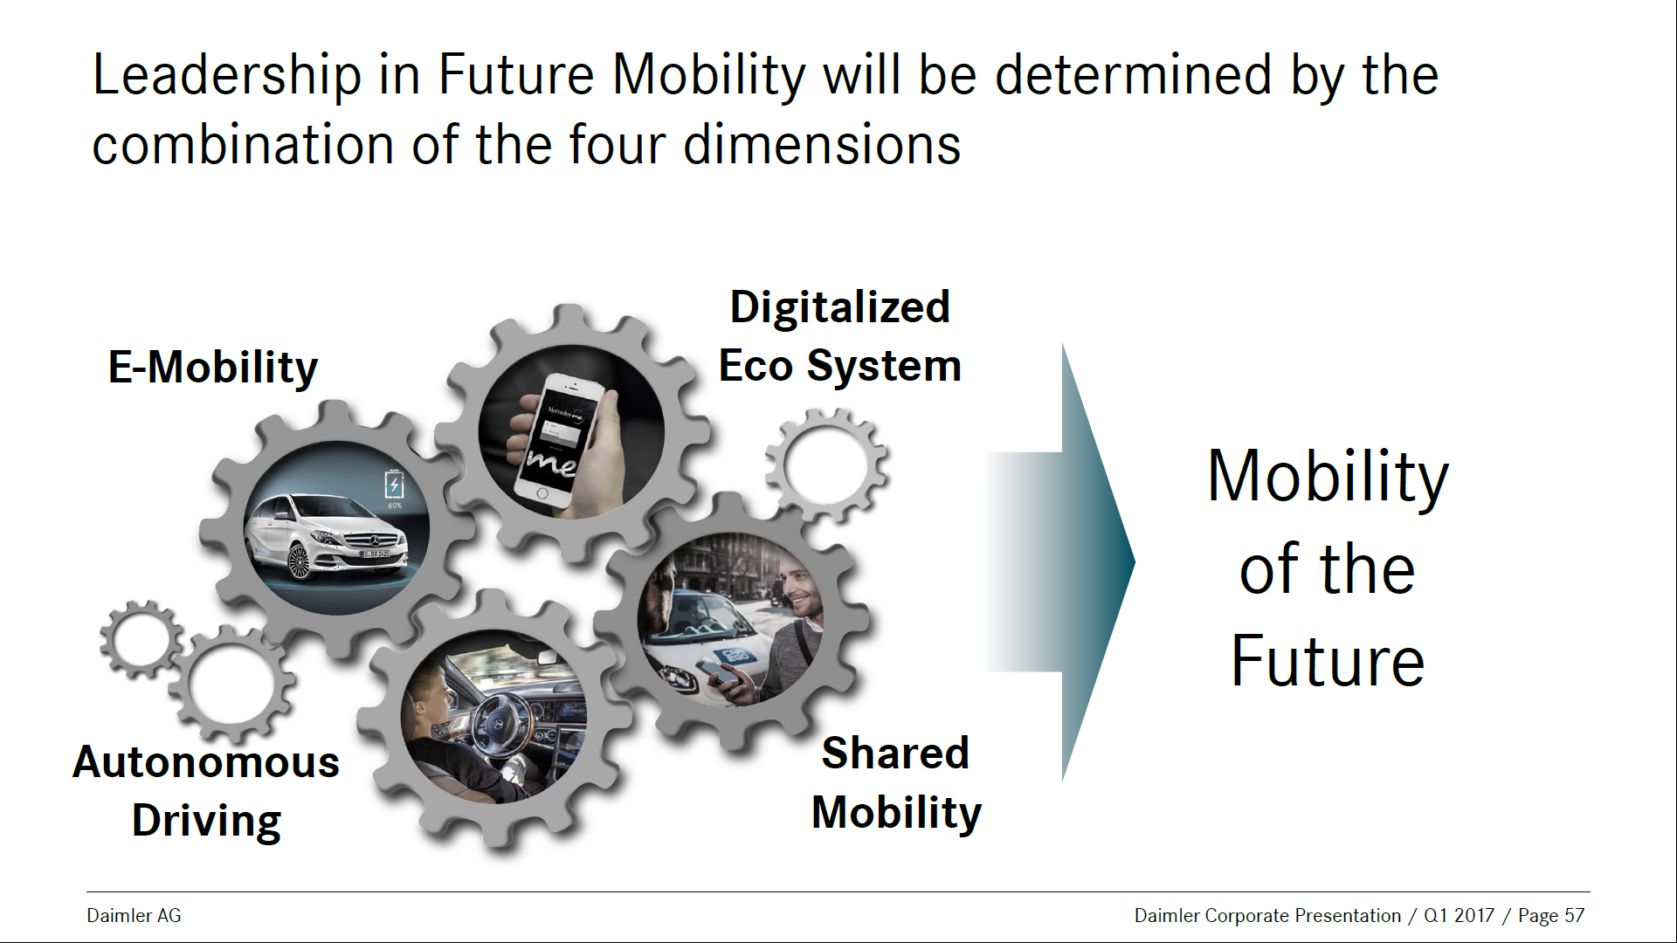

Slide 7
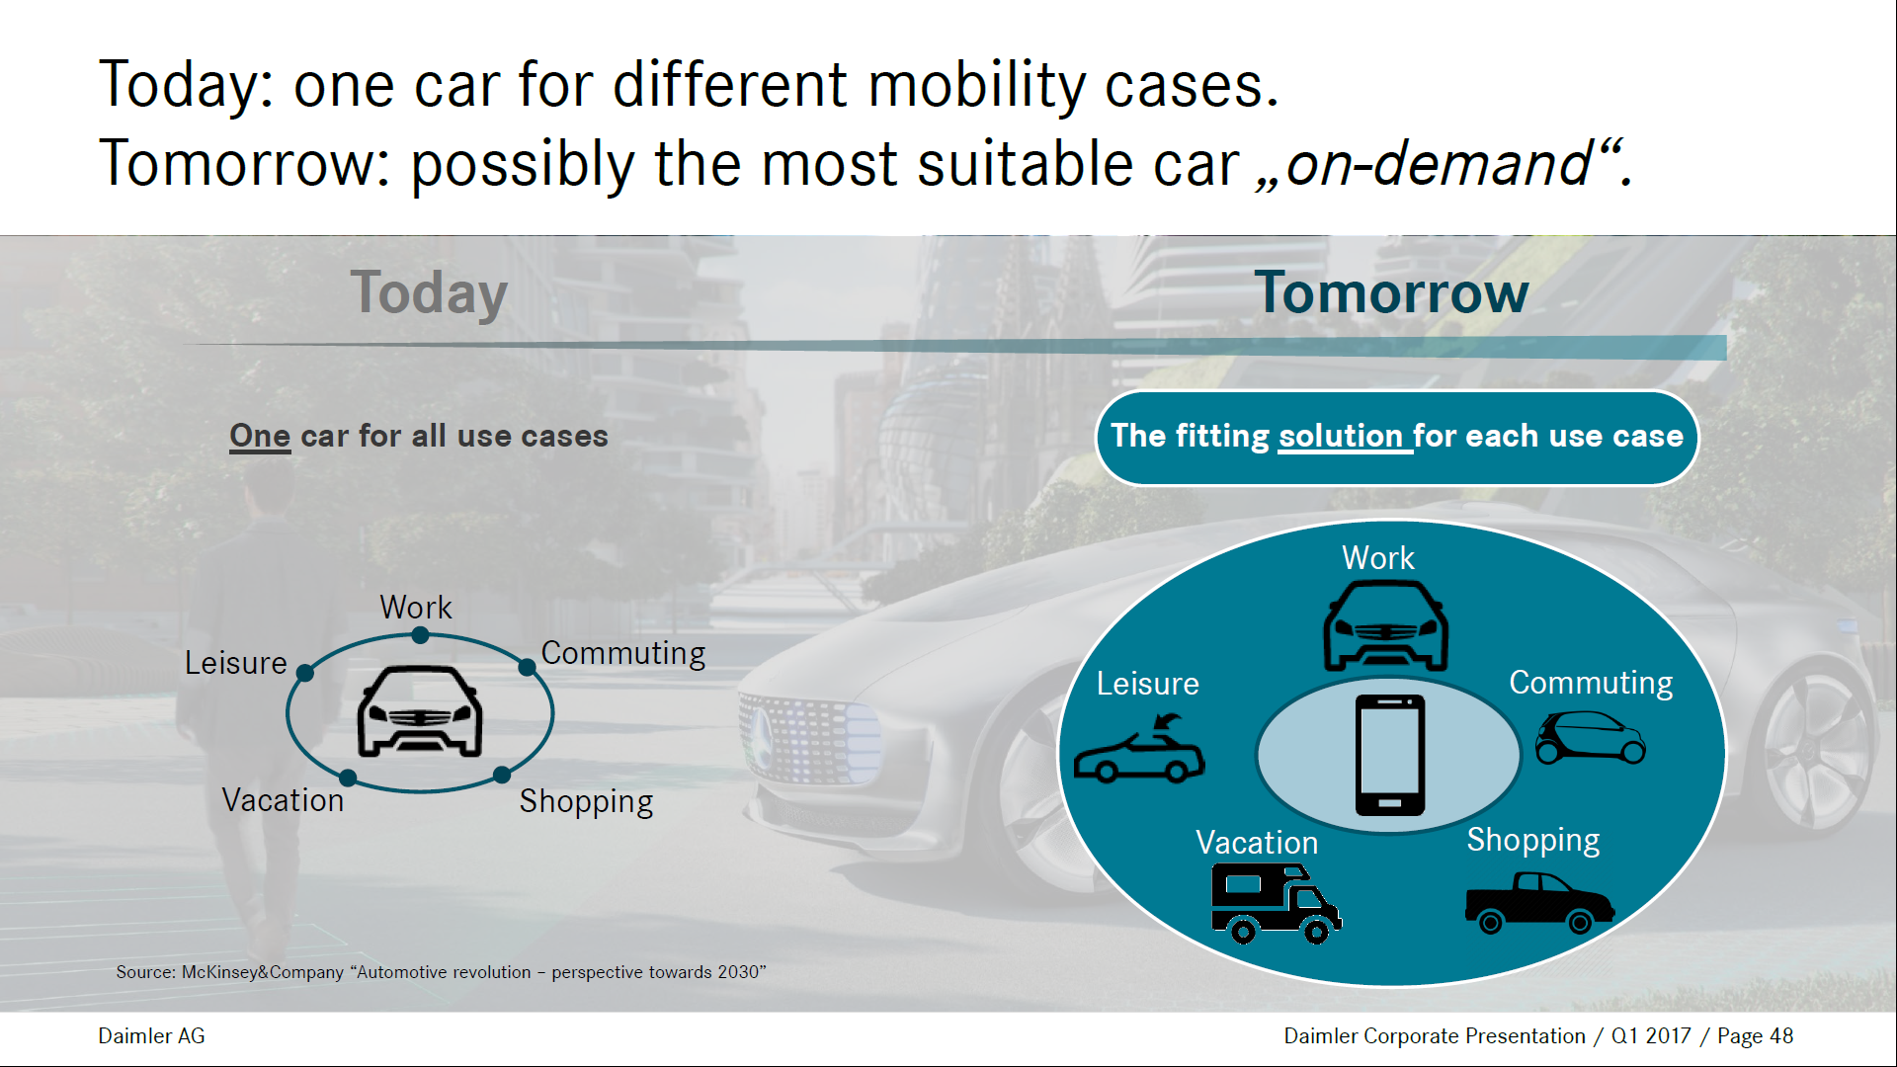

Slide 8
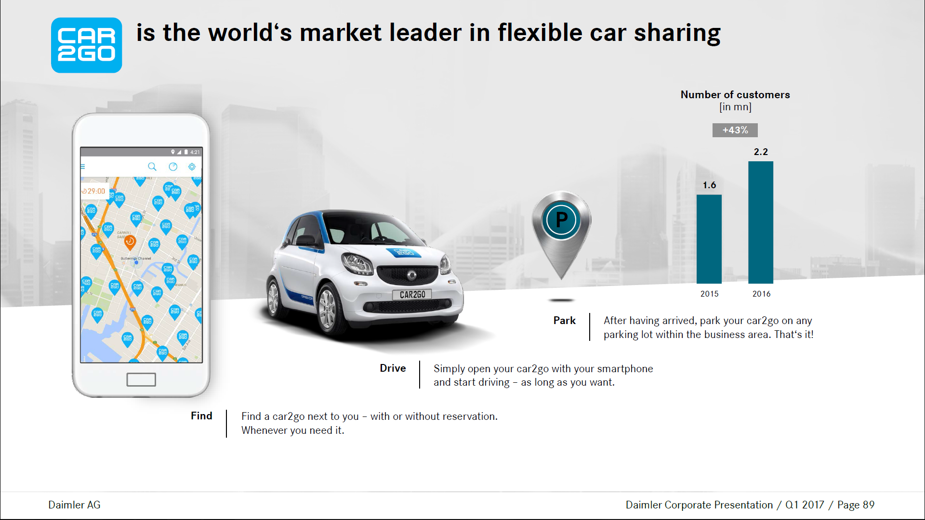

Slide 9
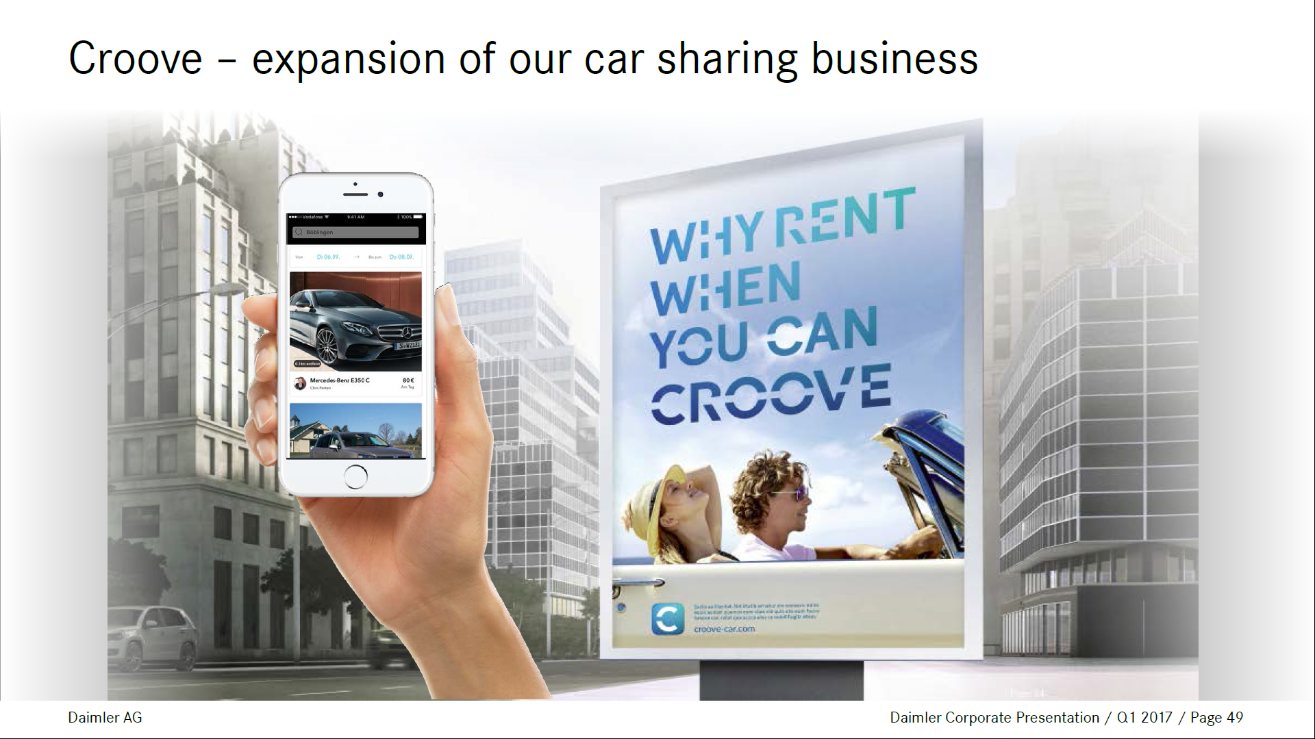

Slide 10
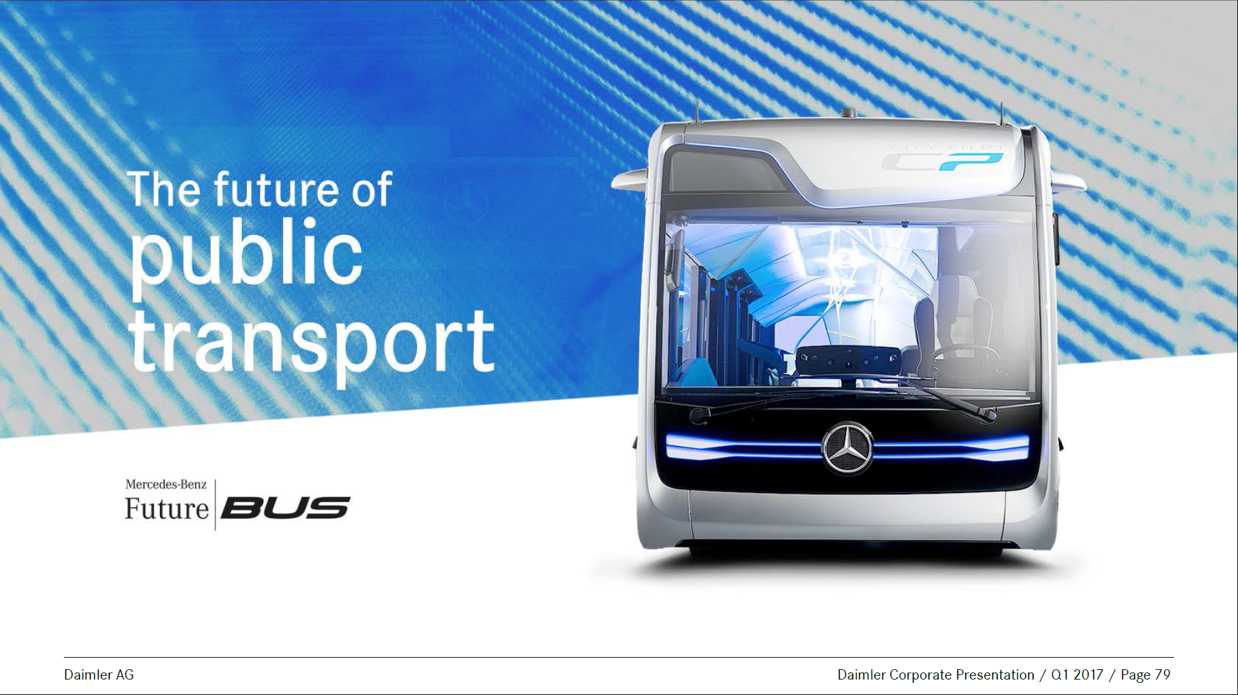

Slide 11
COMMUTER PROGRAMS
BEST PRACTICES WORKSHOP

Slide 12

InterContinental Hotels Group
Commuter Pilot and Flexible Work Arrangements
Charlotte Wolf-Tarfa
© 2017 IHG. All rights reserved.
Proprietary and confidential – further reproduction or distribution is prohibited

Slide 13
History & Objectives
1 1
Notes:
kristen

Slide 14
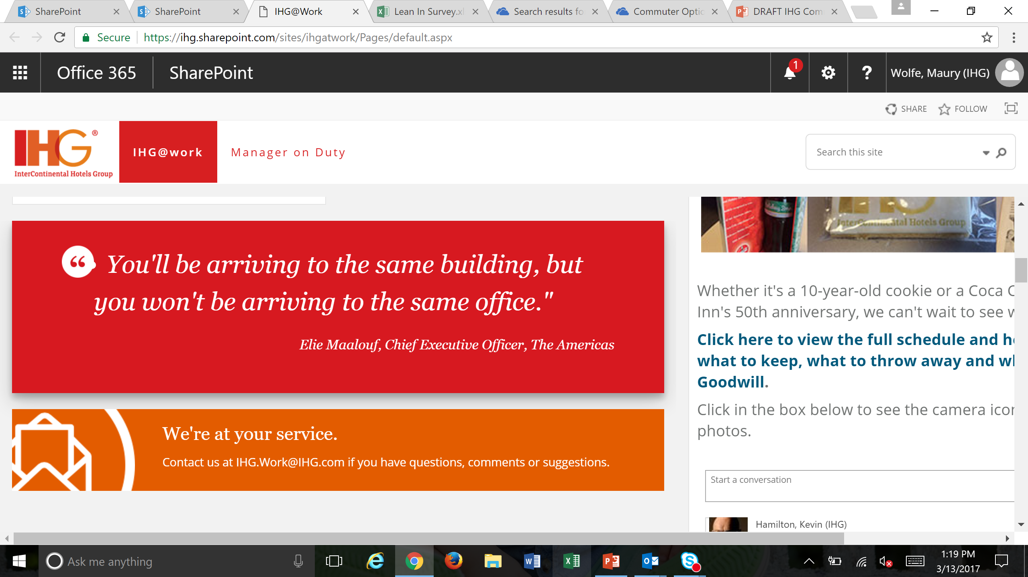
Our goal is to adjust the arrival experience at IHG to better match the new work place.
IHG’s Ravinia office faces several challenges; traffic, parking, roadwork and highway construction. Our goal as an Employer of Choice is to design a new commuting package that eases some of this challenge and better aligns IHG with leading Perimeter and Atlanta companies.
As we know with our guests, sometimes how we get to our destination can be just as important as the experience once we arrive.

Slide 15
IHG Travel Survey
2
Partnership with Perimeter Connects

Slide 16
IHG Travel Survey 2016
50% of employees
arrive at work
between 8.00-9.00am
58% of employees leave work between
4.00-5.30pm
More than 50% dissatisfied with commute
26% are satisfied
39% of employees
spend 30-60 min
commuting to work
80.5% of employees
drive alone
Under 16% of employees have daily childcare
transportation
responsibilities
Notes:
IHG@Work partnered with Perimeter Community Improvement Districts (PCID) to utilize their expertise via Perimeter Connects, PCID’s commuting and transportation experts.
Perimeter Connects designed a survey for IHG to understand the current behavior of our employees, interest in alternative commuting and the necessary incentives to drive change.
623 employees participated
Most IHG surveys result in ~10% returns, this is a significant response rate.
The survey focused on employees currently based in Ravinia in order to understand opportunities for behavior change.
Perimeter Connects would like to connect with our Alpharetta colleagues more directly via lunch and learns and a separate survey.
Perimeter Connects also linked IHG with case studies and lessons learned from other local companies to design a suggested program.
Key lesson learned: Changing commuting behavior at scale can take two years to fully adopt. This creates an urgency for IHG to act in the near-term.

Slide 17
Responses
Positive attitudes towards commute modes:
73% Feels driving to work is faster than public transportation
44% Is willing to ride an IHG provided vanpool
38% Ability to telework
37% Is willing to carpool with someone they do know
30% Free transit pass
Employees did not respond well to:
Riding a bike or walking
Carpooling with someone they do not know
Riding public transportation
Someone to ride with me the first time I take the bus/ train
Chance to win prizes
Help in figuring out when/ where to catch bus/ train

Slide 18
Senior Leadership
Recommendation
3

Slide 19





Long Term Recommendation For IHG Commuter Program
Implement
Flexible culture
Non-Parking Incentives
Carpool
Shuttle Pilot
Marketing
Employees can work from home, alternative locations, staggering days based on department and job responsibility to ensure business continuity and in- office presence.
Aligns with HR Flexible Work Recommendations
Provide cash incentive for employees to give up parking at the Ravinia. Support this by providing assistance with alternative commuter options (Carpool, MARTA, GRTA, Biking/walking).
Provide two parking passes/month and provide 5 “Guaranteed ride home” through GDOT
Implement an IHG-based carpool program, utilizing existing technology to connect potential ride matches.
Insight into arrival times, stops, schedules: on mobile, onsite TV’s, website, etc. to increase awareness and easy usage/ accessibility
Identify appropriate location in Alpharetta for pick up/drop off. Determine set schedule and offer a shuttle for employees with drop down desks and wi-fi.
Long term decision on price to employee TBD.
Kick off/ Market commute program in collaboration with Perimeter Connects.
Include all program information in the employee handbook/benefits package and during onboarding at the same time as parking instructions.
Work with management to condense meetings to the middle of the day, allowing employees with the flexibility to arrive and leave based on the train or bus schedule or to match their carpool partners.
More than 30% of employees live within 10 miles of Ravinia. A significant percentage of employees live along MARTA, and more are located within the average distance from the GRTA Xpress bus park and ride lots.
44% are willing to ride an IHG provided Van Pool, 30% are more likely to take the bus/ train if offered a free transit pass. 19% is willing to carpool for a small cash incentive.
Incentivize carpool partners via cash incentive to relinquish parking.
There is a dense population of employees located within close proximity of colleagues.
A dense population of employees are located in the Alpharetta area with high traffic congestion and limited commuting options. A shuttle is becoming a leading practice for major companies. Removing these drivers from the road would support traffic and parking reductions.
Many employees live outside of the transit system, leading to longer commute times, but a better opportunity for flexible work.
Over 98% of employees would work from home 1+ days per week.
28% of respondents would be more likely to carpool if provided assistance finding a carpool partner with whom they could share the driving responsibilities.
KEY Recommendation
Rationale
Private and confidential
Notes:
Charlotte
How thoughtful we can be around matching (common interests, not just location)
Assigned parking in deck for carpoolers? Bob to follow up with Preferred Office Properties.
Easy access when you come in to work, get in, park and get to your desk without having to drive around to find parking.

Slide 20
Commuter Pilots
4
Notes:
Anna

Slide 21
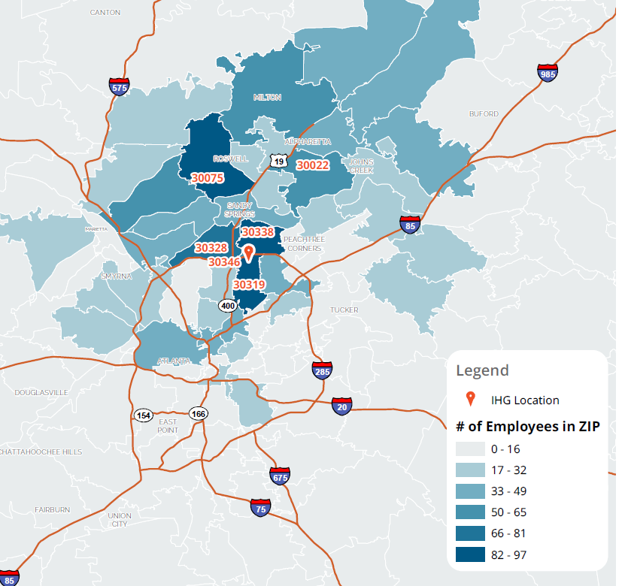

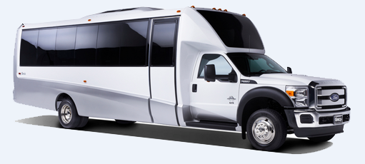

Pilot Proposal for Steering Committee
Group 1: Cash Incentive Pilot.
$ x per month to use alternative commuter options
Details:
IHG provides financial incentive for giving up the benefit of a parking space.
Individuals determine their own alternative commute.
Options available:
  Flexible work
  Carpooling
  MARTA
  Perimeter Connects for support
Group 2: Pilot IHG shuttle from Alpharetta for four weeks. 20-25 participants
Details:
Non-stop shuttle from P&R location to office
WIFI
Front door drop off
Two pick up times in morning and afternoon
Sign up during IHG@Work Fair and identified employees through IHG Travel Survey
Lunch & Learn
Notes:
Kristen

Slide 22
Flexible Work
Arrangements
5

Slide 23
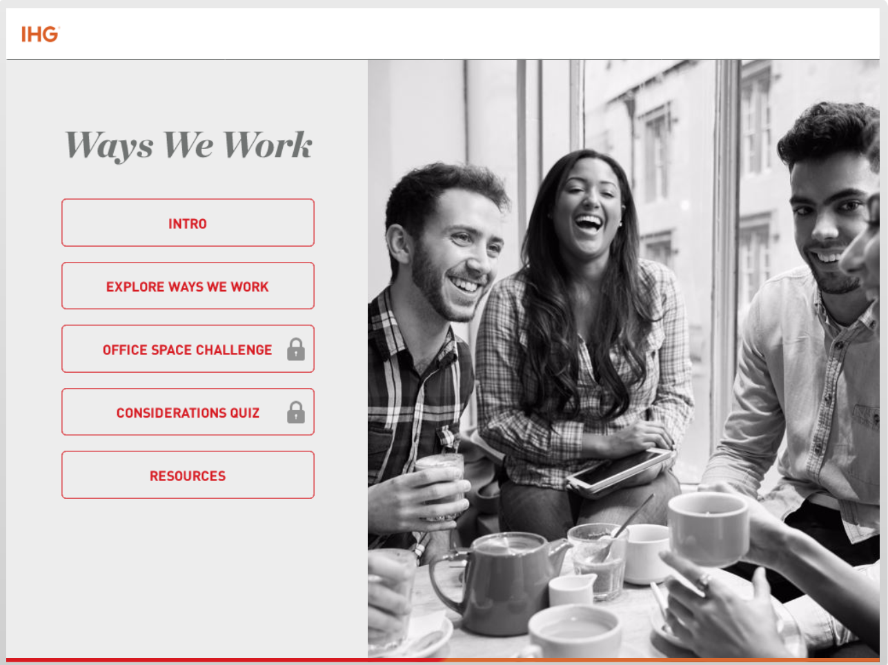
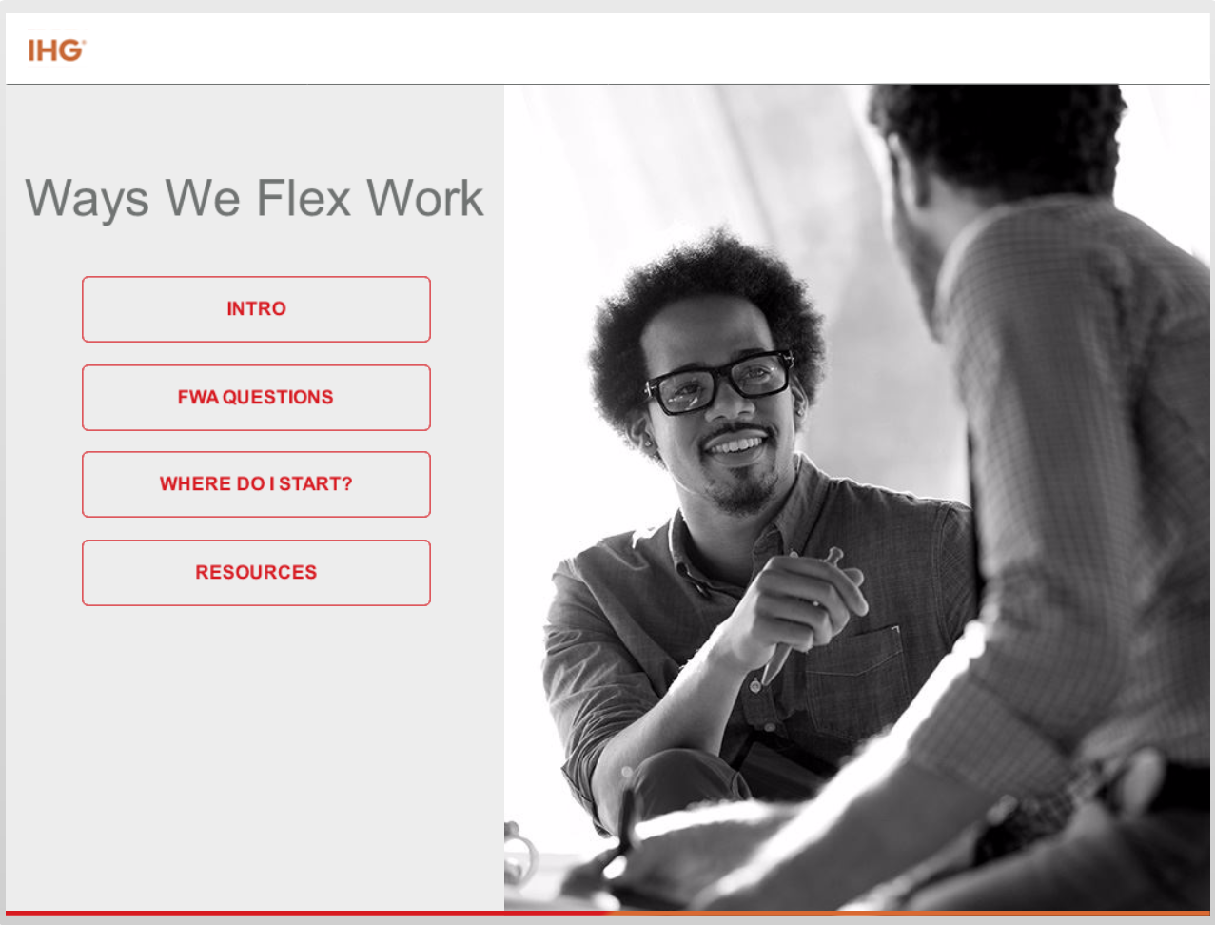
Create an environment where employees can be at their best
Attract and retain a talented and diverse workforce
Increase productivity and engagement
Strengthen our culture of collaboration, trust and accountability
Empower work life fit for all employees
Proficient technology tools and solutions usage
Weave well being throughout
2 online modules

Slide 24
Charlotte Wolf-Tarfa
Specialist, Talent Development & Performance
+1 678 294 0042
Charlotte.wolf-tarfa@ihg.com

Slide 25
COMMUTER PROGRAMS
BEST PRACTICES WORKSHOP

Slide 26

Vmware Americas sites
Seattle
New York City
San Francisco
Boston
Washington DC
Denver
Atlanta
Austin
Costa Rica

Slide 27
Step One: identify opportunity
Classify sites as tier 1 or tier 2 based on opportunity
Identify transit accessibility at sites, how are employees currently obtaining transit passes?
Are there local support organizations that can help?
How far do employees typically commute to each site?

Slide 28

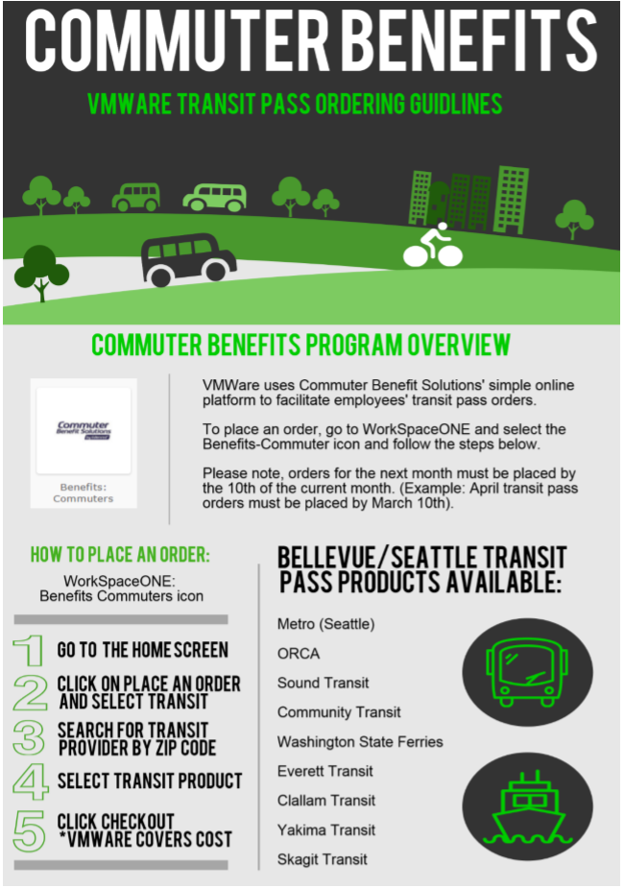
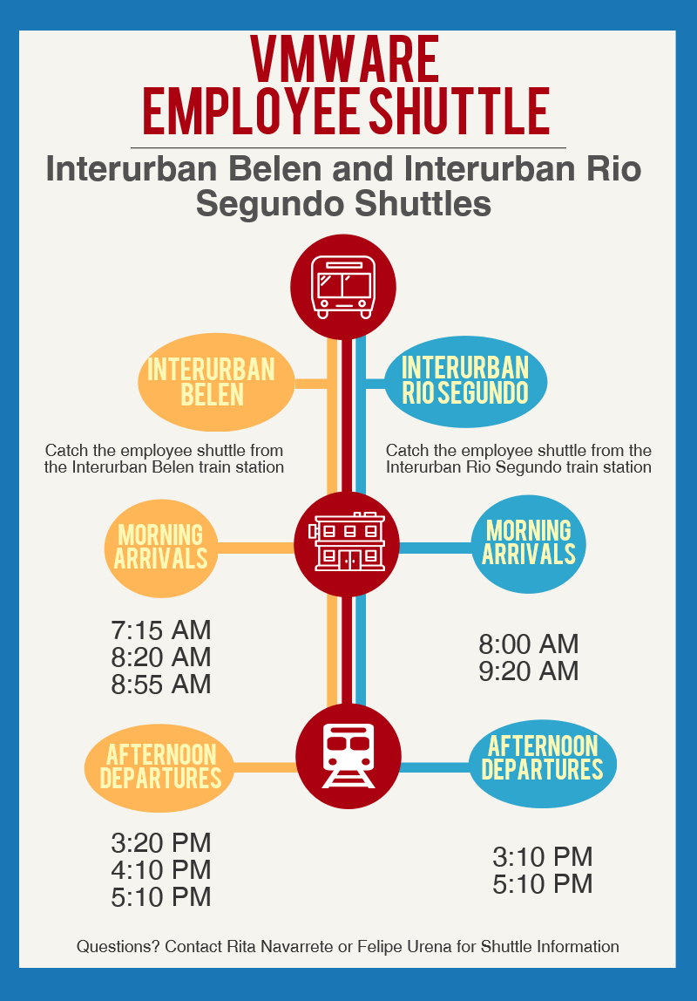
Step Two: company support programs

Slide 29
Step three: plan internal administration of programs
Intranet Support?
Parking Management- onsite, through property management, etc.
New Hire Orientations
Transit Vendors
Evaluation of programs and budgets

Slide 30









Step four: identify local support organizations
Incentives
Programs
Discounts
Transportation Infrastructure Improvements

Slide 31
THANK YOU!

